Slide 1
Fundamental principles
Definition of Engineering
Engineering is the profession in which knowledge (math and natural sciences gained by study, experience and practice) is applied with judgment to develop ways to utilize, economically, the materials and forces of nature for the benefit of mankind.
Two environments are needed for the work of an engineer – physical and – economical environments
An engineer needs to establish efficiency in both environments that are not independent

Slide 2
Engineering Process
Determination of objectives
Identification of strategic factors
Determination of means (engineering proposals)
Evaluation of engineering proposals
Assistance in decision making
Engineering Economic Studies
Creative step
Definition step
Conversion step to same scale to facilitate comparative evaluation
Decision step

Slide 3
EXAMPLES: – Infrastructure expenditure decision – Replace versus repair decisions – Selection of inspection method – Selection of a replacement for an equipment
Economics deals with the behavior of people
Utility – “Utility is the power of a good or service to satisfy human needs”
Value – Value designate the worth that a person attaches to an object or service – Value is a measure or appraisal of utility in some medium of exchange. – Value is not the same as cost or price

Slide 4
Consumer and Producer Goods
Consumer goods are the goods and services that directly satisfy human wants. For example, TV, shoes, houses.
Producer goods are the goods and services that satisfy human wants indirectly as a part of the production or construction process. For example, factory equipment, industrial chemicals ands materials
The Utilities of Goods
Consumer goods: Basic human needs of food, clothing and shelter. In commercial advertisements, emphasis is given to senses not reasoning. The utility in this case is considered objectively and/or subjectively.
Producer goods: The utility stems for their means to get to an end. The utility in this case is considered objectively.

Slide 5
Economy of Exchange
Economy of exchange occurs when utilities are exchanged by two or more people.
It is possible because consumer utilities are evaluated subjectively.
Mutual benefit in exchange
Persuasion in exchange. Salesperson
Economy of Organization
Through organizations, ends can be attained or attained more economically by: 1. Labor saving 2. Efficiency in manufacturing or capital use

Slide 6
The Interest Rate
Called also the rate of capital growth, it is the rate of gain received from an investment.
It is expressed on an annual basis.
For the lender, it consists, for convenience, of (1) risk of loss, (2) administrative expenses, and (3) profit or pure gain.
For the borrower, it is the cost of using a capital for immediately meeting his or her needs.
The Time Value of Money (TVM)
As a result of the earning power of money (through interest), time increases the purchasing power of money by its increase through earning

Slide 7
The Time Value of Money (TVM)
Money has a time value
One dollar today is worth more than $1 tomorrow (exchange rate)
Failure to pay the bills results in additional charge termed interest
The earning power of money
This power is there because money can be exchanged by production tools
The purchasing power of money
The prices of goods and services can go upward or downward, therefore the purchasing power of money can change with time

Slide 8
Introduction to Engineering Economics
Efficient functioning of any business organization would enable it to provide goods/services at a lower price.
In the process of managing organizations, the managers at different levels should take appropriate economic decisions which will help in minimizing investment, operating and maintenance expenditures besides increasing the revenue, savings and such other gains of the organization.
These can be achieved through Engineering Economics which deals with the methods that enable one to make economic decisions towards minimizing costs and/or maximizing benefits to business organizations.

Slide 9
Economics - is a study of economic problems of the people concerning production, consumption, exchange and distribution of wealth.
Economics is the science that deals with the production and consumption of goods and services and the distribution and rendering of these for human welfare.
The following are the economic goals.
A high level of employment
Price stability
Efficiency
An equitable distribution of income
Growth

Slide 10
Demand and Supply
Demand curve shows the number of units people are willing to buy and cost per unit (decreasing curve).
Supply curve shows the number of units that vendors will offer for sale and unit price (increasing curve).
The intersection defines the exchange price.
Elasticity of demand. Price changes and their effect on demand changes. It depends on whether the consumer product is a necessity or a luxury.
Law of diminishing return. A process can be improved at a rate with a diminishing return. Example: cost of inspection to reduce cost of repair and lost production.

Slide 11
Laws of supply and demand
Laws of supply - states that the quantity of a commodity supplied varies directly with the price, other determinants of supply remaining constant.
If the cost of inputs increases, then naturally, the cost of the product will go up. In such a situation, at the prevailing price of the product the profit margin per unit will be less.
The producers will then reduce the production quantity, which in turn will affect the supply of the product.

Slide 12
Laws of supply contd.
For instance, if the prices of fertilizers and cost of labour are increased significantly, in agriculture, the profit margin per bag of paddy will be reduced.
So, the farmers will reduce the area of cultivation, and hence the quantity of supply of paddy will be reduced at the prevailing prices of the paddy.
If there is an advancement in technology used in the manufacture of the product in the long run, there will be a reduction in the production cost per unit.
This will enable the manufacturer to have a greater profit margin per unit at the prevailing price of the product. Hence, the producer will be tempted to supply more quantity to the market.

Slide 13
Laws of supply contd.
Weather also has a direct bearing on the supply of products. For example, demand for woollen products will increase during winter. This means the prices of woollen goods will be increased in winter.
So, naturally, manufacturers will supply more volume of woollen goods during winter.
Factors influencing supply
Cost of the inputs
Technology
Weather
Prices of related goods

Slide 14
Law of demand states that other things being equal demand when price falls and contracts when price rises.
Market demand is the total quantity demanded by all the purchasers together.
Elasticity of Demand - Elasticity of demand may be defined as the degree of responsiveness of quantity demanded to a Change in price.
An interesting aspect of the economy is that the demand and supply of a product are interdependent and they are sensitive with respect to the price of that product.
From Fig. it is clear that when there is a decrease in the price of a product, the demand for the product increases and its supply decreases.

Slide 15
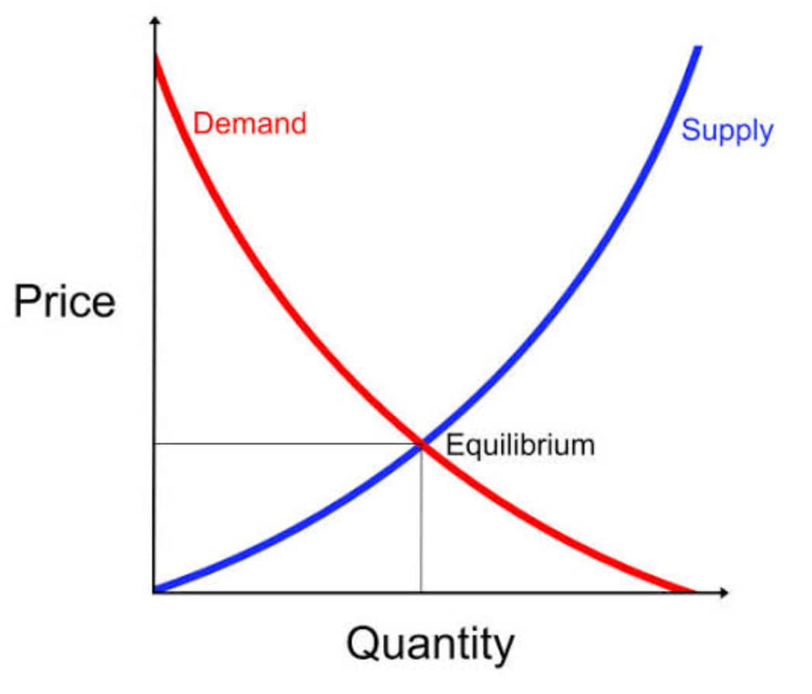
Also, the product is more in demand and hence the demand of the product increases.
At the same time, lowering of the price of the product makes the producers restrain from releasing more quantities of the product in the market.
Hence, the supply of the product is decreased. The point of intersection of the supply curve and the demand curve is known as the equilibrium point.
At the price corresponding to this point, the quantity of supply is equal to the quantity of demand. Hence, this point is called the equilibrium point.

Slide 16
Factors influencing demand
Price of the product
The consumers’ income
Prices of related goods
Tastes and preferences of consumers
Consumers’ expectations/ Expectation of future change in price
Number of consumers in the market
Weather condition
Advertisement
Government policy (taxation)
Availability of credit facilities

Slide 17
Shift in Demand
A shift in demand occurs when the determinants of demand change. When taste, preferences and income are altered, the basic relationship between price and quantity demanded changes (shifts). The shift in the entire demand curve upward and is called increase while a downward shift is called decrease in demand.
D₁
D
D_{o}
Price
D₁
D
D_{o}
Quantity Demanded

Slide 18
The movement along a demand curve can take place due to price rise or fall. When price falls, more of the commodity is purchased and vice versa.
D
P₁
a
P
b
Price
P_{O}
c
D
Q₁
Q
Q_{O}
Quantity Demanded

Slide 19
Types of Demand
Direct and Indirect
Derived and autonomous
Durable and non durable goods demand
Firm and Industry demand
Total market / Segment demand
Short run / Long run demand
Joint / Composite demand
Price demand / Income demand / Cross demand

Slide 20
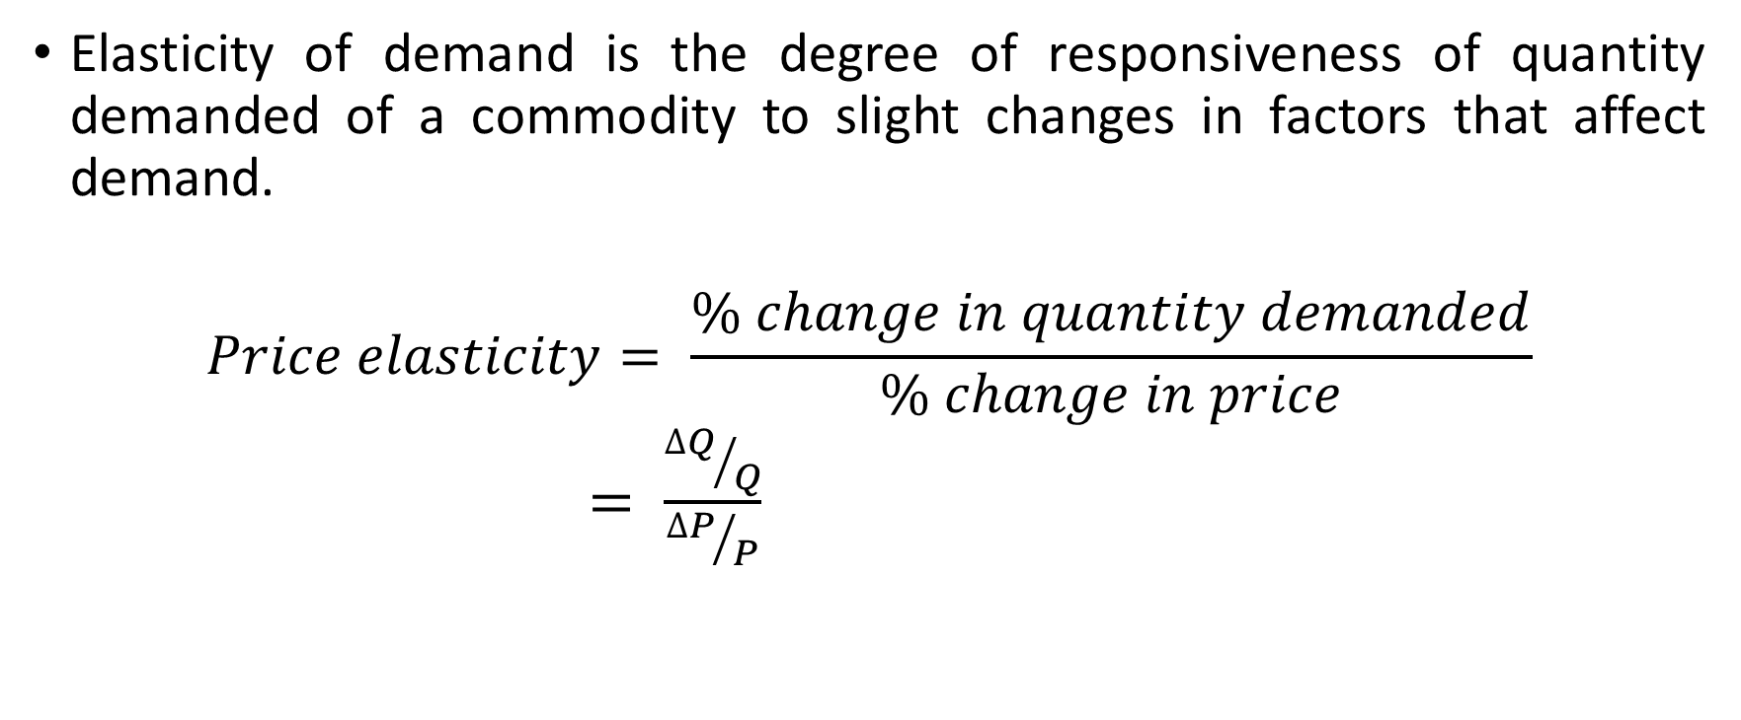
Elasticity of Demand

Slide 21
Cross Elasticity
Cross Elasticity = Percentage Change in Quantity Demanded of A/ Percentage Change in Price of B
Theories of elasticity is useful in making decisions on:
Production
Price Fixation
Distribution
International Trade
Public Finance

Slide 22
Class activity 1
The demand for a product rises from 500 units to 600 units where the price of a particular product reduces from N25 000 to N22 000. Find the cross elasticity of demand for the two products. What is the nature of their relationship?

Slide 23
Production
Definition
The principal aim of any economic activity is creation of utility (satisfaction); hence, all activities that provide utility or which assist to provide satisfaction in the future time are regarded as production. Firms are involved in production processes and they refer to entities created by persons to organize and spur production. A firm makes use of factors of production to transform resources into good and services and which eventually create utility.

Slide 24
Types of Production
Primary Production: This is done by extractive industries like agriculture, mining, oil industry. The activities involve extraction of ores and other natural resources from beneath the earth crust, water bodies etc.
Secondary Production: This is largely manifested in manufacturing activities in the various industries involved in making finished and semi finished products from crude materials.
Tertiary Production: The production activities involved here include all services which cause finished goods to reach final consumers. Activities in this category include warehousing, wholesales, retailing, haulage, communication, banking, insurance, law, health etc

Slide 25
Factors of Production
These are resources that are combined together to achieve creation of utility. Each Factor gets rewarded based on its contribution to the production process. These factors include:
Entrepreneur:
An individual or group of individuals which forms an entity called firm. The reward of an enterprise or entrepreneur is profit. This factor is concerned with decision making, management control, division of income, risk taking and bearing of uncertainties, innovations etc

Slide 26
Capital:
These are man made resources whose rewards manifest as interests. They can be classified as fixed or circulating.
Land: Refers to any natural resource. The reward of land is rent. The supply of land is limited although reclamation is possible in some sense. Although fixed in supply, lands have alternative uses. Land is not homogenous and values vary from place to place. It may be subject to diminishing returns and it is not mobile.
Labour : These are skilled and unskilled persons employed to create utility and whose rewards manifest as wages.

Slide 27
Elements Of Costs
Cost can be broadly classified into variable cost and overhead cost.
Variable cost varies with the volume of production while overhead cost is fixed, irrespective of the production volume.
Variable cost can be further classified into direct material cost, direct labour cost, and direct expenses.
The overhead cost can be classified into factory overhead, administration overhead, selling overhead, and distribution overhead.
Direct material costs are those costs of materials that are used to produce the product.
Direct labour cost is the amount of wages paid to the direct labour involved in the production activities.

Slide 28
Elements Of Costs Contd.
Direct expenses are those expenses that vary in relation to the production volume, other than the direct material costs and direct labour costs.
Overhead cost is the aggregate of indirect material costs, indirect labour costs and indirect expenses.
Administration overhead includes all the costs that are incurred in administering the business.
Selling overhead is the total expense that is incurred in the promotional activities and the expenses relating to sales force.
Distribution overhead is the total cost of shipping the items from the factory site to the customer

Slide 29
Other Costs/Revenues
First (or initial) cost: Cost to get activity started such as property improvement, transportation, installation, and initial expenditures)
Operation and maintenance cost: They are experienced continually over the useful life of the activity
Incremental or marginal cost: Cost per unit or production increase. It is determined from the variable cost.
Sunk cost: It cannot be recovered or altered by future actions. Usually this cost is not a part of engineering economic analysis.
Life-cycle cost: Feasibility, design, construction, operation and disposal costs

Slide 30
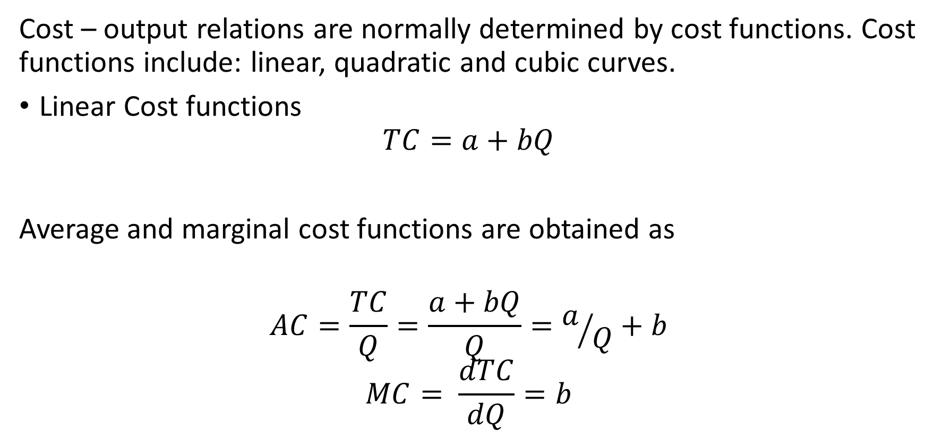
Cost Functions
Where a = Total fixed cost
bQ = Total variable cost

Slide 31
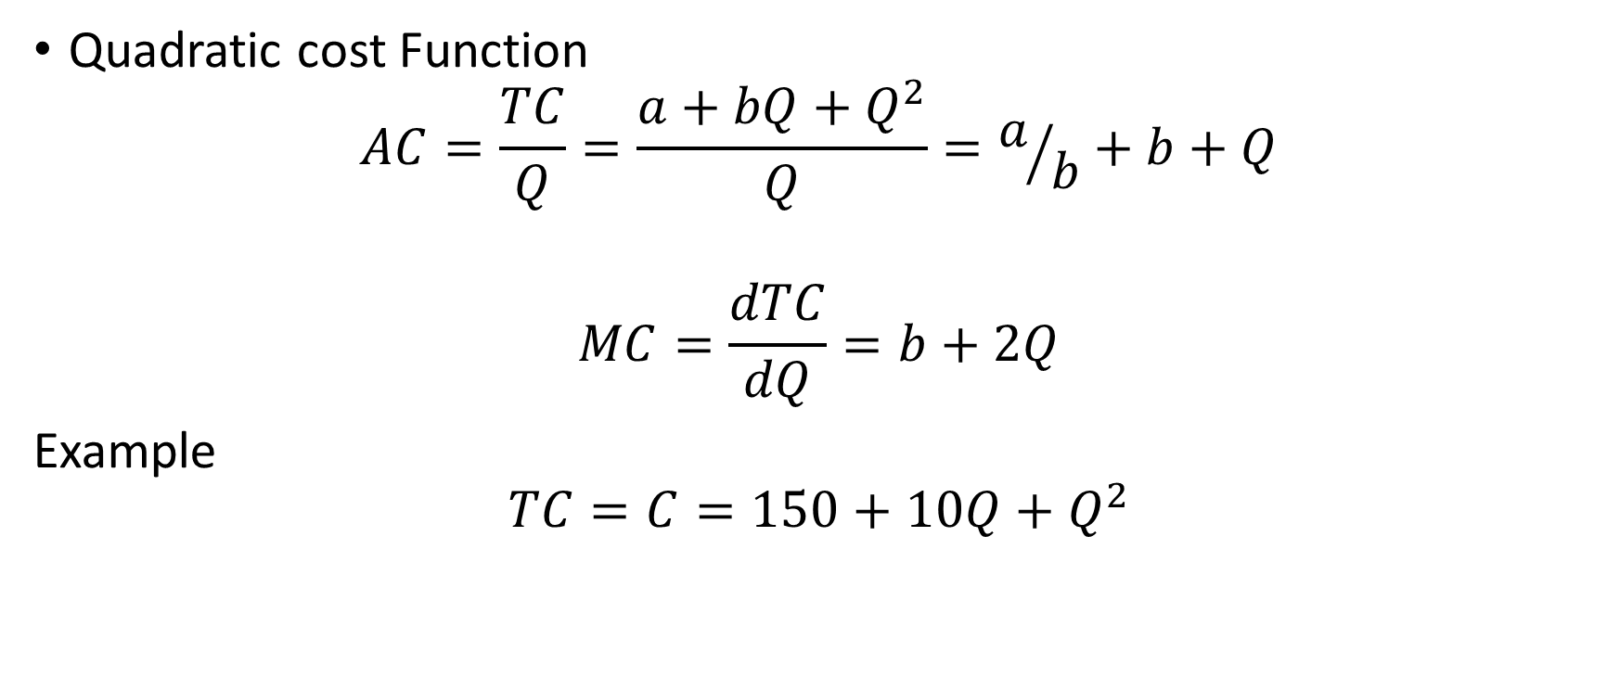
Cost Function Contd.

Slide 32
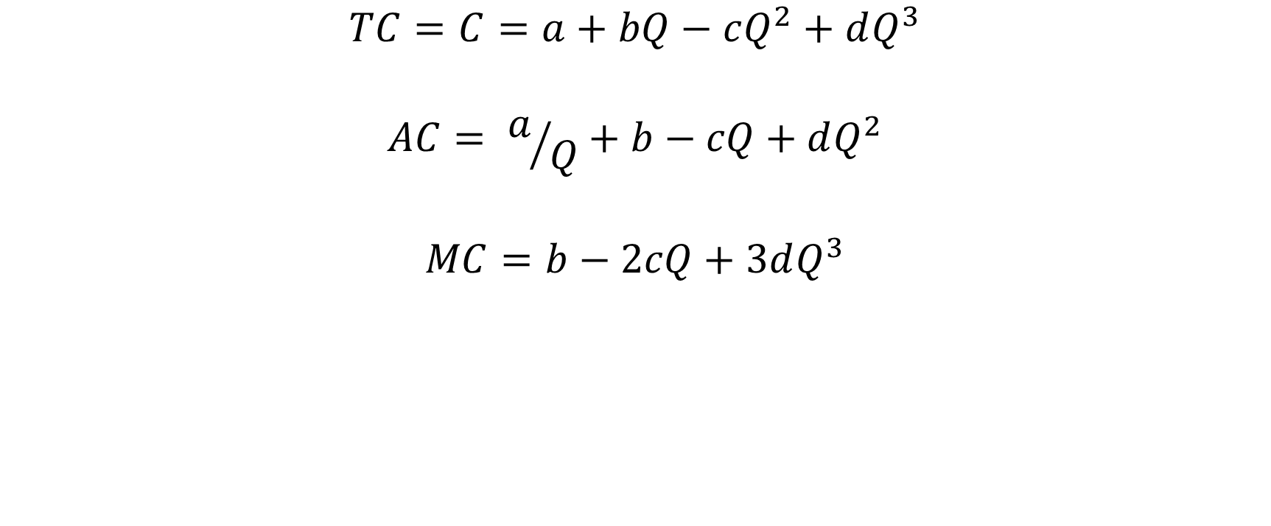
Cubic Cost Function

Slide 33
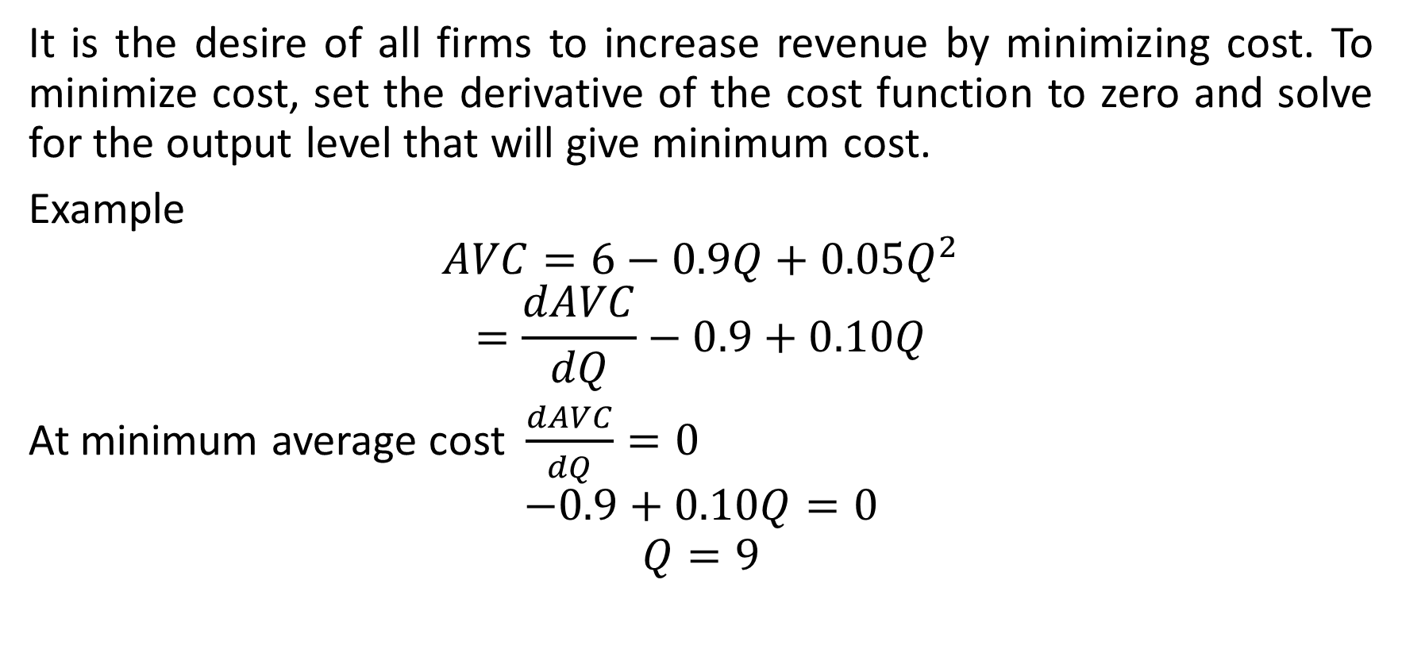
Class activity 2: Cost Minimization

Slide 34
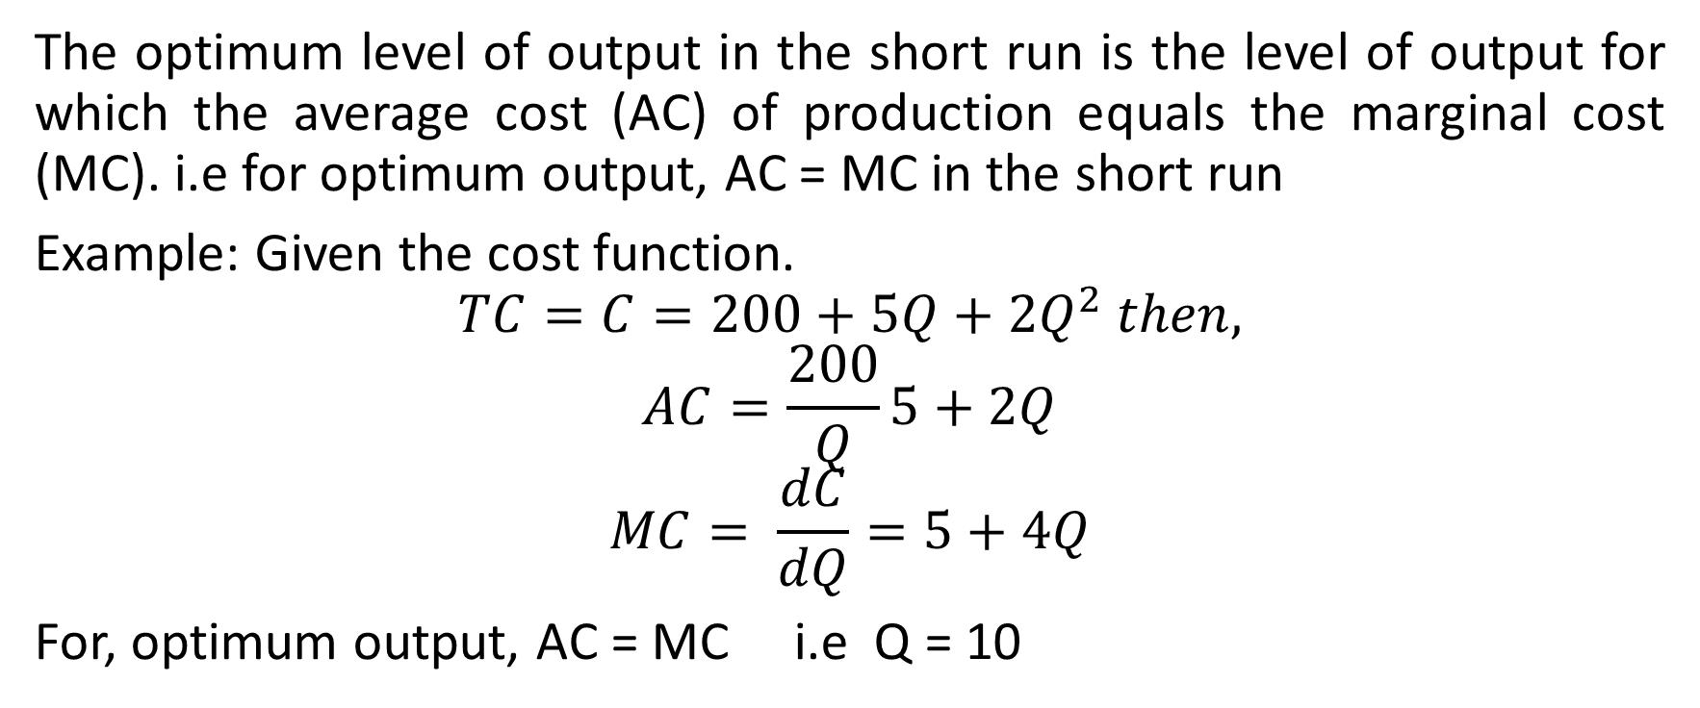
Class activity 3: Output optimization in short run

Slide 35
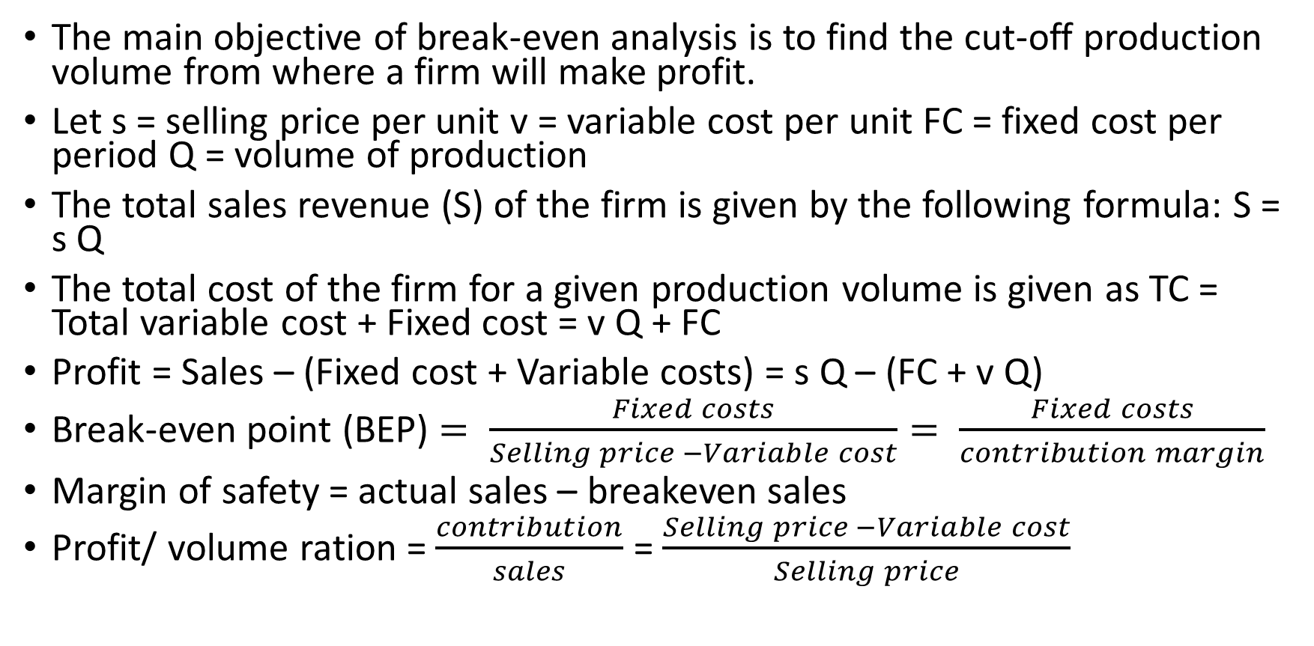
Break-Even Analysis
The main objective of break-even analysis is to find the cut-off production volume from where a firm will make profit.
Let s = selling price per unit v = variable cost per unit FC = fixed cost per period Q = volume of production
The total sales revenue (S) of the firm is given by the following formula: S = s Q
The total cost of the firm for a given production volume is given as TC = Total variable cost + Fixed cost = v Q + FC
Profit = Sales – (Fixed cost + Variable costs) = s Q – (FC + v Q)
Break-even point (BEP) $= \frac{Fixed costs}{Selling price −Variable cost}= \frac{Fixed costs}{contribution margin}$
Margin of safety = actual sales – breakeven sales
Profit/ volume ration = $\frac{contribution}{sales}$ = $\frac{Selling price −Variable cost}{Selling price}$

Slide 36
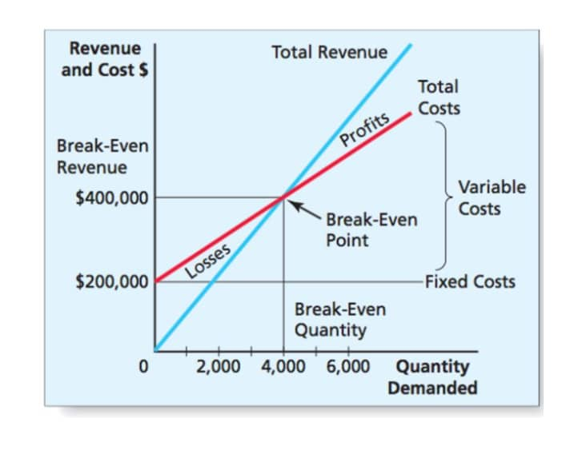
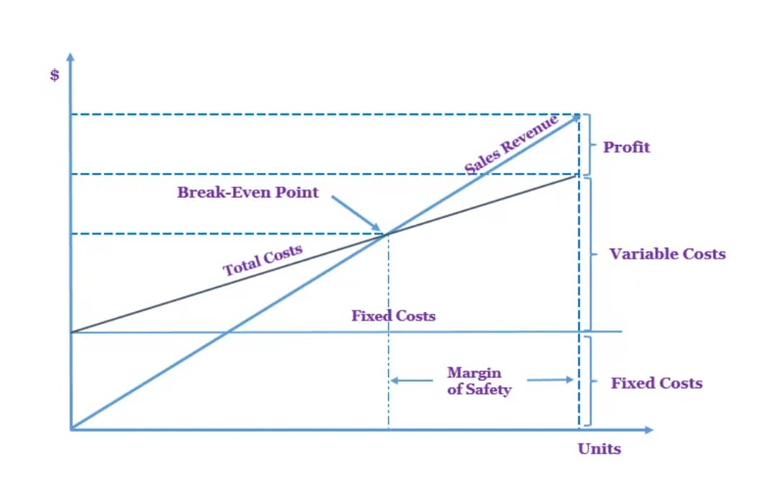

Slide 37
Elementary Economic Analysis
Whether it is a business situation or a day-to-day event in somebody’s personal life, there are a large number of economic decision making involved. One can manage many of these decision problems by using simple economic analysis. For example, an industry can source its raw materials from a nearby place or from a far-off place. In this problem, the following factors will affect the decision:
Price of the raw material
Transportation cost of the raw material
Availability of the raw material
Quality of the raw material

Slide 38
Elementary Economic Analysis Contd.
Consider the alternative of sourcing raw materials from a nearby place with the following characteristics:
The raw material is more costly in the nearby area.
The availability of the raw material is not sufficient enough to support the operation of the industry throughout the year.
The raw material requires pre-processing before it is used in the production process. This would certainly add cost to the product.
The cost of transportation is minimal under this alternative

Slide 39
Elementary Economic Analysis Contd.
On the other hand, consider another alternative of sourcing the raw materials from a far-off place with the following characteristics:
The raw material is less costly at the far off place.
The cost of transportation is very high.
The availability of the raw material at this site is abundant and it can support the plant throughout the year.
The raw material from this site does not require any pre-processing before using it for production

Slide 40
Material Selection For A Product/Substitution Of Raw Material
The cost of a product can be reduced greatly by substitution of the raw materials. Among various elements of cost, raw material cost is most significant and it forms a major portion of the total cost of any product. So, any attempt to find a suitable raw material will bring a reduction in the total cost in any one or combinations of the following ways:
Reduced machining/process time
Enhanced durability of the product
Cheaper raw material price
Therefore, the process of raw material selection/substitution will result in finding an alternate raw material which will provide the necessary functions that are provided by the raw material that is presently used. In this process, if the new raw material provides any additional benefit, then it should be treated as its welcoming feature. This concept is demonstrated with numerical problem given below:

Slide 41
Example: In the design of a jet engine part, the designer has a choice of specifying either an aluminium alloy casting or a steel casting. Either material will provide equal service, but the aluminium casting will weigh 1.2 kg as compared with 1.35 kg for the steel casting. The aluminium can be cast for $80.00 per kg. and the steel one for $35.00 per kg. The cost of machining per unit is $150.00 for aluminium and $170.00 for steel. Every kilogram of excess weight is associated with a penalty of $1,300 due to increased fuel consumption. Which material should be specified and what is the economic advantage of the selection per unit?

Slide 42
Solution (a) Cost of using aluminium metal for the jet engine part:
Weight of aluminium casting/unit = 1.2 kg;
Cost of making aluminium casting = $80.00 per kg;
Cost of machining aluminium casting per unit = $150.00
Total cost of jet engine part made of aluminium/unit = Cost of making aluminium casting/unit + Cost of machining aluminium casting/unit = 80*1.2 + 150 = 96 + 150 = $246
(b) Cost of jet engine part made of steel/unit:
Weight of steel casting/unit = 1.35 kg;
Cost of making steel casting = $35.00 per kg;
Cost of machining steel casting per unit = $170.00;

Slide 43
Solution Contd.
Penalty of excess weight of steel casting = $1,300 per kg
Total cost of jet engine part made of steel/unit = Cost of making steel casting/unit + Cost of machining steel casting/unit + Penalty for excess weight of steel casting = 35*1.35 + 170 + 1,300*(1.35 – 1.2) = $ 412.25
DECISION The total cost/unit of a jet engine part made of aluminium is less than that for an engine made of steel.
Hence, aluminium is suggested for making the jet engine part.
The economic advantage of using aluminium over steel/unit is Rs. 412.25 – Rs. 246 = Rs. 166.25

Slide 44
Design Selection for a Product
a. The design modification of a product may result in reduced raw material requirements, increased machinability of the materials and reduced labour. b. Design is an important factor which decides the cost of the product for a specified level of performance of that product.
Assignment 1: (Design selection for a process industry). The chief engineer of refinery operations is not satisfied with the preliminary design for storage tanks to be used as part of a plant expansion programme. The engineer who submitted the design was called in and asked to reconsider the overall dimensions in the light of an article in the Chemical Engineer, entitled “How to size future process vessels?” The original design submitted called for 4 tanks 5.2 m in diameter and 7 m in height. From a graph of the article, the engineer found that the present ratio of height to diameter of 1.35 is 111% of the minimum cost and that the minimum cost for a tank was when the ratio of height to diameter was 4 : 1. The cost for the tank design as originally submitted was estimated to be N900,000. What are the optimum tank dimensions if the volume remains the same as for the original design? What total savings may be expected through the redesign?

Slide 45
Hint: (Diameter of the new design, cost of the new design and expected savings by the redesign).
Process Planning /Process Modification
While planning for a new component, a feasible sequence of operations with the least cost of processing is to be considered.
The process sequence of a component which has been planned in the past is not static.
It is always subject to modification with a view to minimize the cost of manufacturing the component.
So, the objective of process planning/process modification is to identify the most economical sequence of operations to produce a component.
Example: The process planning engineer of a firm listed the sequences of operations to produce a component as: (1). Turning – Milling – Shaping – Drilling (2). Turning – Milling – Drilling (3). All operations are performed with CNC machine (computer numerical controlled)

